Slide 2
Blooms Ball
1. Carefully cut out twelve circles from construction paper You will be using one circle to complete each of the twelve steps.
2. Before completing each of the following steps, be certain to observe where the fold lines are. Do not write or draw outside of the lines.
3. Complete steps 1-12 below in your circles. Be very neat and add color. You may write directly on circles if the paper is a light color or you may type it and glue to the circle.
4. Decorate the edges of your circles. your choice. Fold each circle on the straight lines so that the edges are facing to the
outside.
5. When all of the other steps are completed, glue or staple the circles together. Be sure all the edges are facing out! You can attach a string for hanging the bloom ball.

Slide 3
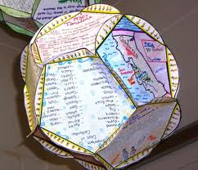
Social Studies Project
Map of Latin America: Label All Countries (In standard) and physical features
Map of Canada: Label All Countries (in standard)and physical features
Map of Europe: : Label All Countries (in standard) and physical features
Map of Australia: Label All and physical features
Define: Unitary, Confederation, Federation, Oligarchy, Democracy, With pictures
Read Text book Pg. 383-Interpreting Political Cartoons: Complete “Practice It!” (Q: 1-4)
Create a poem about the French and Indian War
Define: God, Gold, Glory…create a picture that represents the idea
Create a Propaganda Poster for World War II
Create 3 Haiku Poems that represent each of the following: Simon Bolivar, Miguel Hidalgo, and Toussaint L’ouverture: Haiku Poem: 5-7-6
Create a Political Cartoon about European Imperialism
Create an original piece of Aboriginal Art Work: Must be in color (Dot Art)
*Check off each task as you complete it. **Make sure all work is colorful and neat.

