Slide 1

Environmental Issues in Europe
6th Grade Social Studies
Sutton Middle School

Slide 2
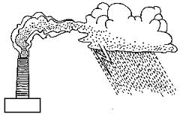
Rain, Rain, Go Away!
Industrial growth in Europe hurt the environment---- and has created serious health risks.
Acid Rain in Germany is a huge problem! Acid rain is formed when gases released into the air by the burning of fossil fuels, like coal or oil. In the 1990’s the former country of East Germany burned massive amounts of brown coal to produce electricity. When burned, brown coal gives off a gas called sulphur dioxide the gas mixes with moisture in the air, so when it rains, the rain is polluted with sulphur dioxide.

Slide 3
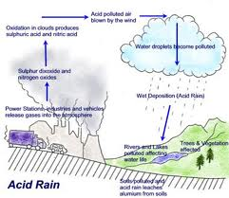
Acid Rain in Germany
Nature plays a part in the acid rain. The toxic smoke from manufacturing plants is carried by air currents to other places before it falls to earth as acid rain. Germany shares its borders with many other countries, therefore, Germany’s problem with acid rain becomes problems for the nearby countries as well.

Slide 4

Fixing The Problem!!
In Southern Germany, plants that use water power from streams and rivers in the region are replacing many coal-burning factories. The government has passed laws to reduce emissions from automobiles and factories. Cars must have special convertors fitted to the exhaust system. Factories are switching to cleaner fuels, and building taller smokestacks that scrub smoke before it enters the air.
Germany is also developing new types of energy. It is the leading producer of wind turbines and solar power technology in the world.

Slide 5
How are they helping to reduce Acid Rain in Germany???
Factories
Cars
Government

Slide 6

Higher Order Questioning
Explain the role nature plays in Germany’s acid rain problem.
How would you have handled the acid rain problem in Germany?
Pretend you are a German government official. How will you explain to Germany’s neighbors what the government is doing to help solve their acid rain problem.
What are some of the possible problems associated with acid rain pollution?

Slide 7

Air Pollution In The UK
Air pollution in the UK has been caused mainly by emissions from factories or from homes burning coal for heat. When the pollution mixes with fog it creates “SMOG” hovering over cities. In 1952 4,000 deaths were recorded due to the Great London Smog of 1952.
Today most of the smog related problems in the UK are caused by emissions from cars and trucks and from ozone. Pollutants from cars include carbon monoxide and nitrous oxides. They hover close the ground, contaminating the air people breathe. Ozone adds to the problem, forming when air pollutants mix and react with sunlight to form smog.

Slide 8
Fixing The Problem
The UK Government has been working hard to reduce air smog. The government has tightened emissions standards for vehicles, endorsed the use of cleaner fuels, and urged citizens to use public transportation like buses and subway “Underground” systems.

Slide 9
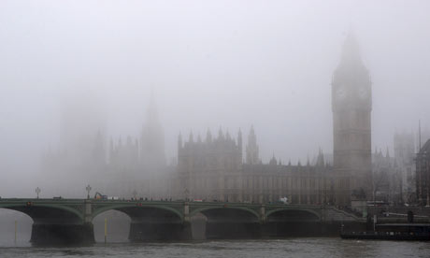
London Smog

Slide 10

Nuclear Disaster in Ukraine
In April of 1986, a nuclear reactor exploded at the Chernobyl nuclear power plant in Ukraine causing the worst nuclear disaster in history. At the time the Ukraine was still apart of the Soviet Union! Toxic radioactive material shot into the air and drifted over parts of the Western Soviet Union, Eastern Europe, and Scandinavia. Roughly 10,000 acres of farmland, forest, crops, and animals were destroyed.
Nearly 350,000 people were evacuated and resettled in other areas. About 30 people died in the blast, and thousands more who were near the site eventually died from radiation poisoning.

Slide 11
Nuclear Disaster in Ukraine
The environmental effects of the disaster have been contaminated farmland, surface water, and groundwater. Today the area near the blast is still considered one of the most contaminated and most polluted places on Earth.
Many adults and children living near the area have been diagnosed with cancer as a result of the horrible blast.

Slide 12



Video Break

